Slide 1

Hackathon Project

Slide 2
Agenda
Pavani
 | Introduction
 | Block Diagram
 | Flow Chart
 | Final Output
 | Example

Slide 3
INTRODUCTION
Pavani
Game Desgin:
In this game, there is a list of words present, out of which our interpreter will choose 1 random word.
The user first has to input their word with blank space and then, will be asked to guess any alphabet.
If the random word contains that alphabet, it will be shown as the output(with correct)
else the program will ask you to guess another alphabet
User will be given 2 attempts to guess the letter. If user guess word with in two attempt it will stop game.

Slide 4
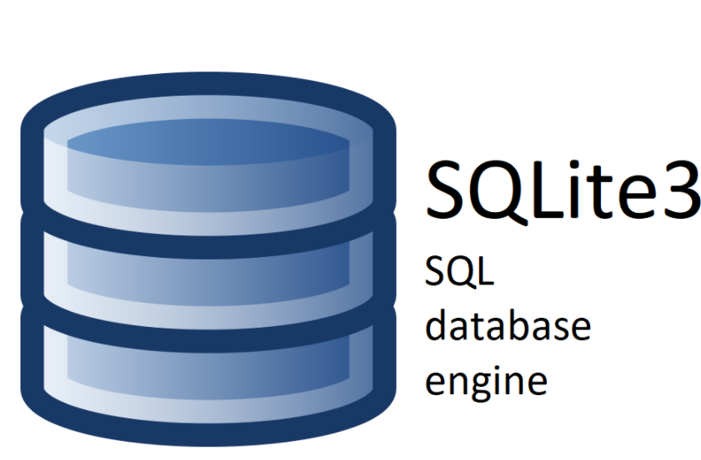

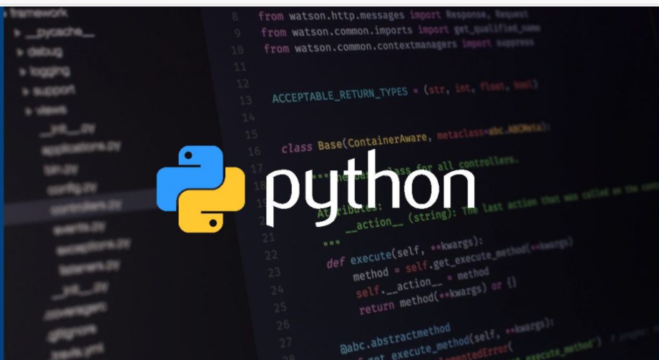
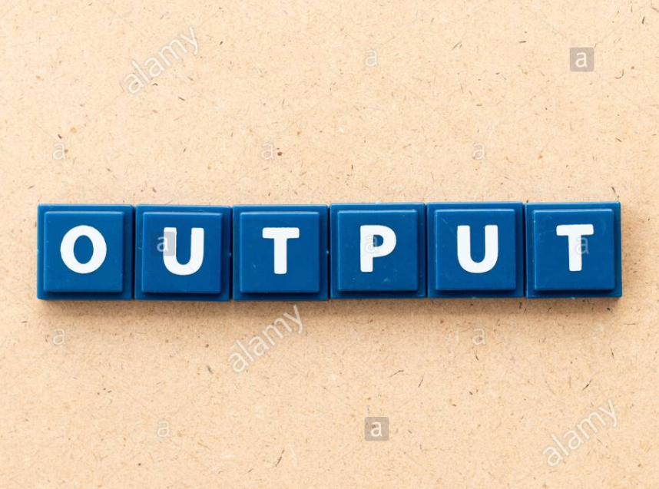
Block diagram :
Pavani
DATABASE selection:
IDE selection:

Slide 5
Flow Chart:
Pavani
start
INPUT=(C_T,D_G)
While
Word!=user guess
If user == word
Else
User!=word
Try again(attempt=2)
False
False
True
True
Print(win)
Print(loose)
stop

Slide 6
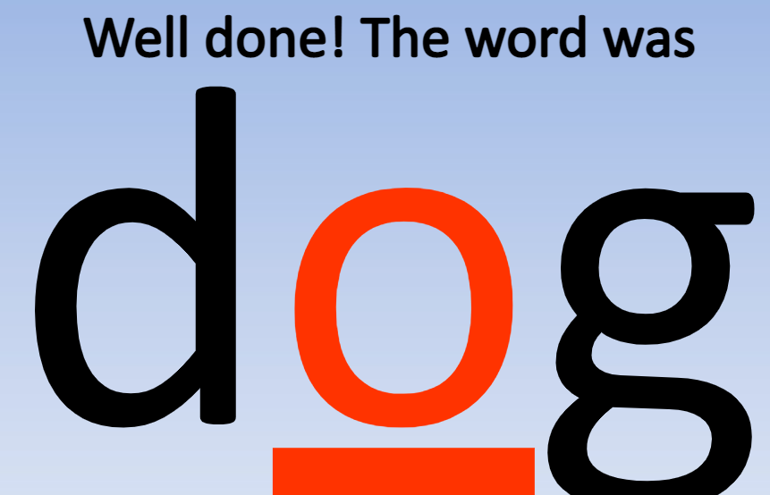


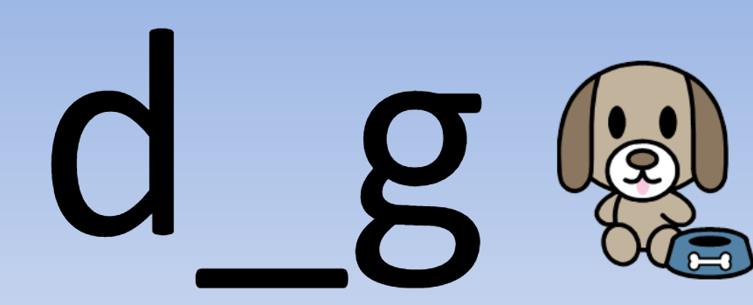


Example:
Pavani

Slide 7
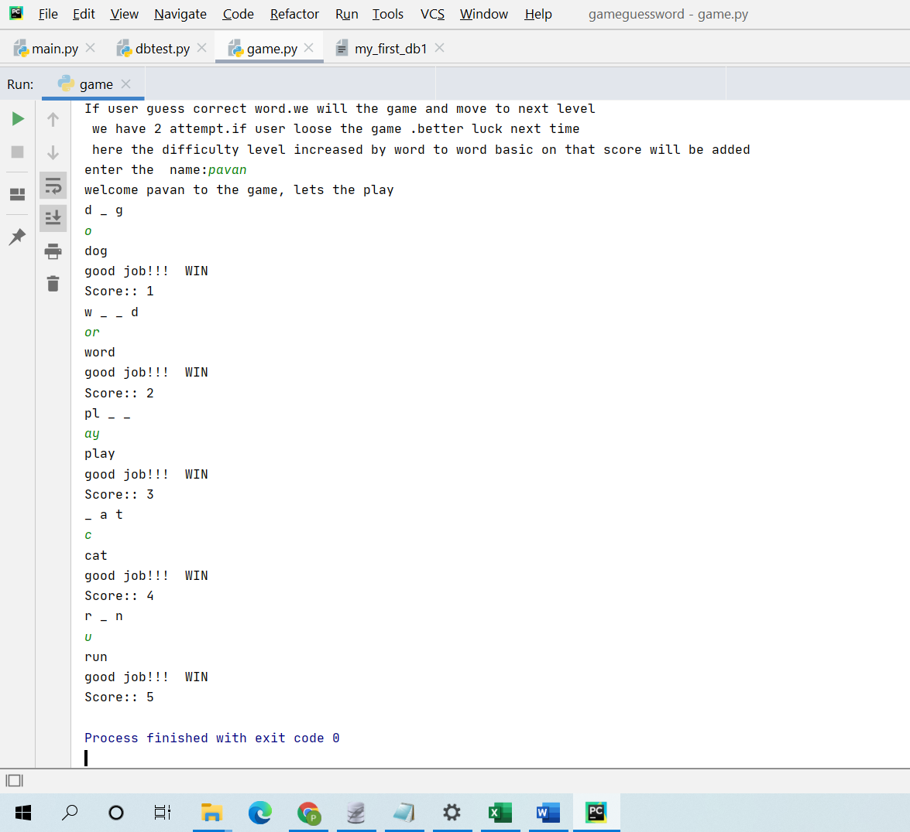
Final Result :
Pavani

Slide 8
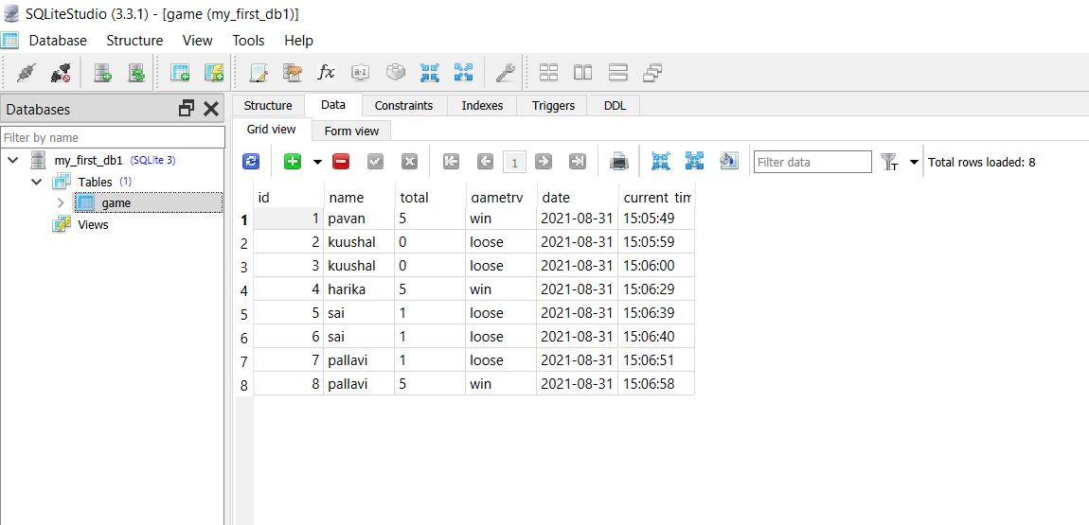
Database Output:
Pavani

Slide 9

Q & A

Slide 10



